Slide 1
360° Review Process in Polarion Author Harish Sahu System Engineer
Confidential ©2024 IAST Software Solutions Pvt. Ltd​

Slide 2
360° Review Process in Polarion
Contents:
Prerequisites
Step 0 : Preparation for initiating review process
Step 1 : Initiating Review
Step 2 : Perform Review
Step 3 : Review Rework
Step 4 : Close review task in consultation with reviewer
Attributes of a review task

Slide 3
Prerequisites
The author and reviewer, both should have Polarion access. If not, then contact Rajashekar/Akash and get approval from your manager.
The requirements to be given for review should be present in Polarion in “proposed” status.
Review checklist (with version history) should be available for the project. If not available, then ask your manager.
One review task should not have more than 15 requirements or 3 MS word pages.

Slide 4
Step 0 : Preparation for initiating review process
Fill review checklist.
Change requirements status from “proposed” to “in review”.

Slide 5
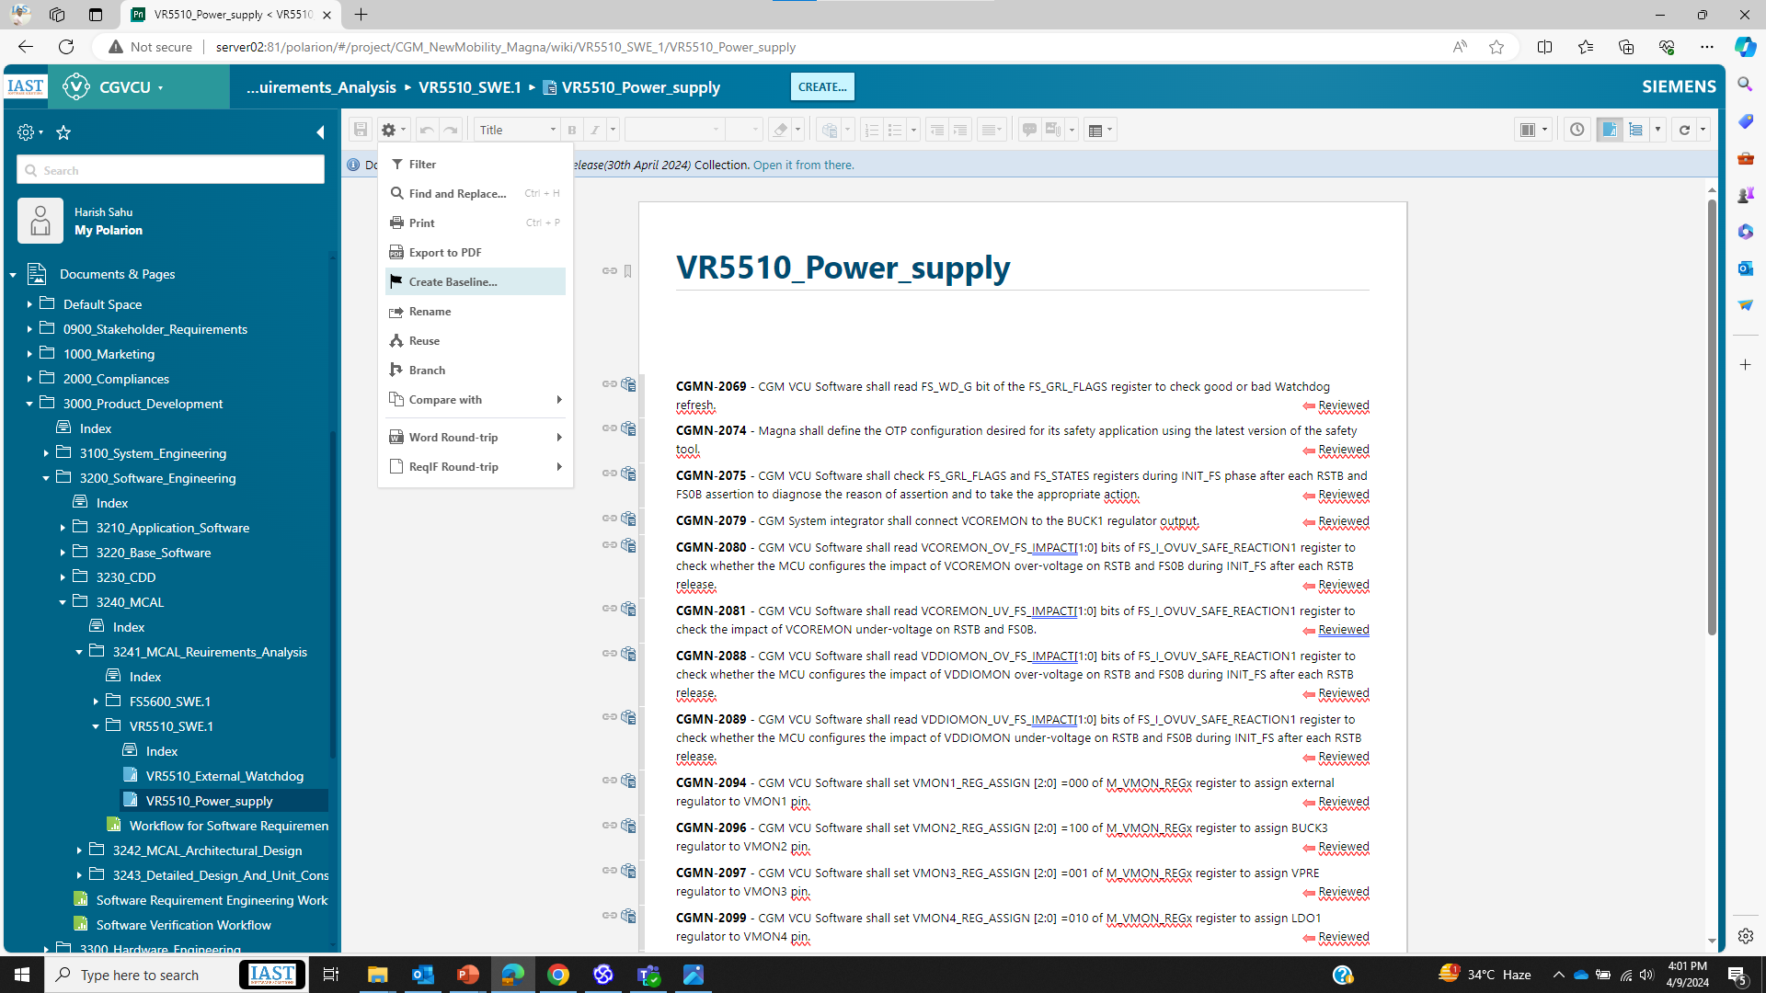
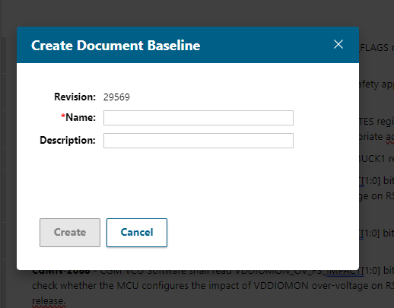
Step 1 : Initiating Review (Author’s Responsibility)
Create a baseline of the document from which you will be proposing requirements for review
1. Click on gear icon
2. Click on create Baseline
3. Give name and description as per Requirement Management Plan
4. Click on Create
CGVCU_Verification Review_VR5510_SWE.2_Power Supply_11042024

Slide 6
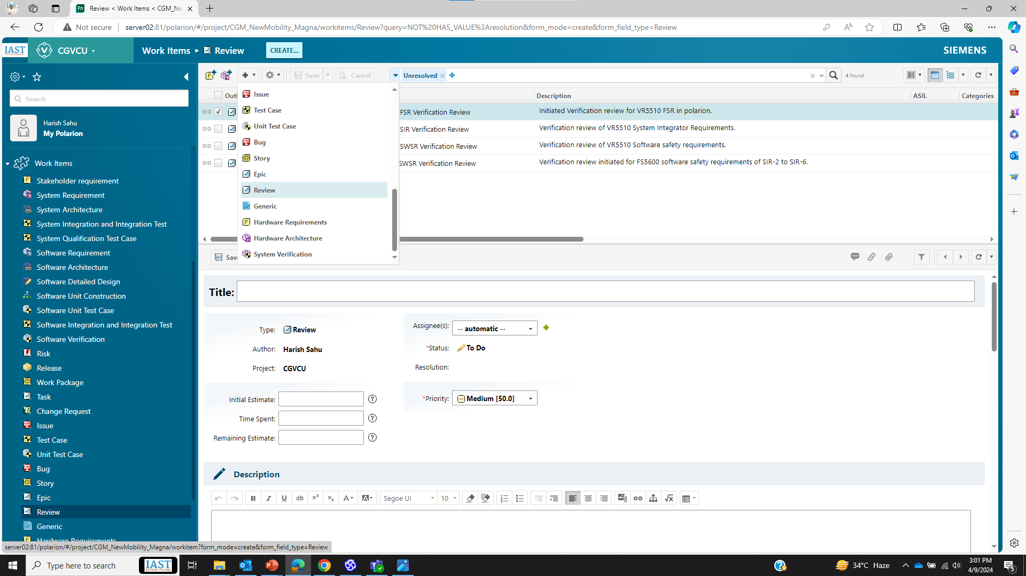
Step 1 : Initiating Review (Author’s Responsibility)
2. Create a review task in Polarion, in the project you are working.
1. Select Project
4. Click on “+” Sign (New)
2. Go to Work Items
5. Click on review
6. Give title for the review task
7. Assign reviewer
3. Click on review
8. Give description of the review task alongwith baseline number.

Slide 7
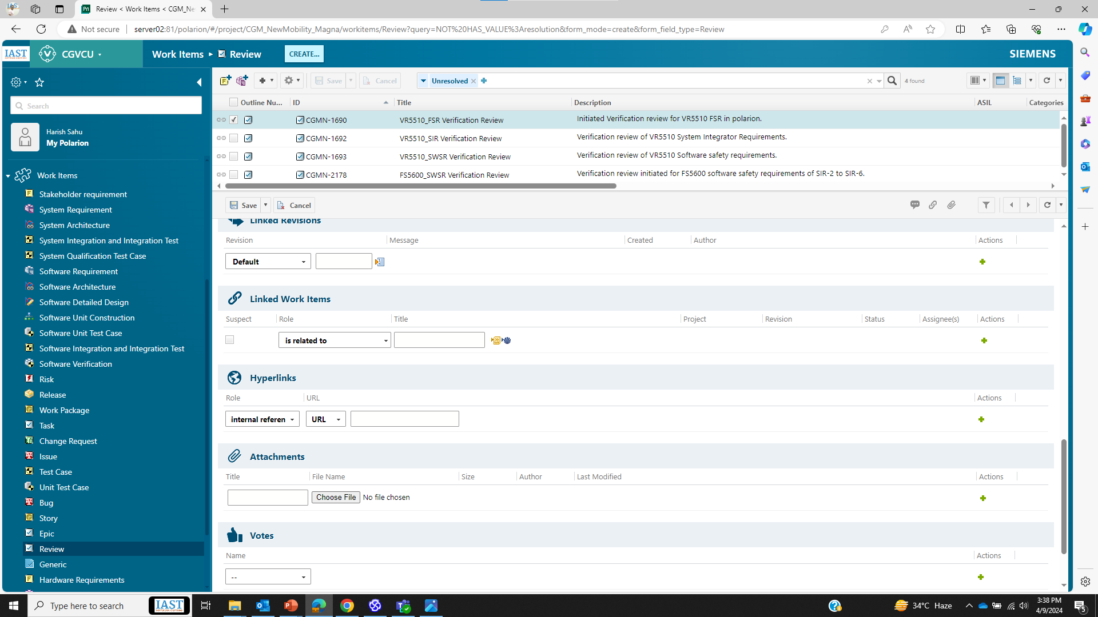
Step 1 : Initiating Review (Author’s Responsibility)
2. Create a review task in Polarion, in the project you are working.
13. Click on save icon to create the review task
14. The created review task will be visible in this pane with the ID
9. Go to Linked work items
10. Select “is related to” relationship
11. Click on this icon to select the requirements to be reviewed under this review task.
12. Attach the review checklist here

Slide 8
Step 1 : Initiating Review (Author’s Responsibility)
Give briefing session to the reviewer regarding scope of the work items and inputs for those work items.
Inform reviewer about review task in mail, so that the communication is documented.

Slide 9
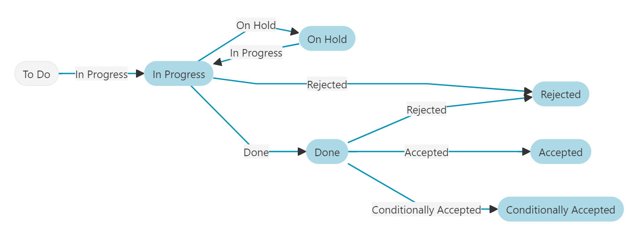
Step 2 : Perform Review (Reviewer’s Responsibility)
Do not start the review without briefing session from author about work items.
Go through the review checklist, which is attached in the review task.
Change the status of review task to “In Progress”.
Perform review of the work items which are related to the review task.
Give review feedback against each work item as a fresh comment in the review task.

Slide 10
Step 3 : Review Rework (Author’s Responsibility)
Author should do the rework in work items as per review findings given by reviewer.
If not agreed with the review finding, then convince the reviewer and reject it.
Author should reply against each comment of reviewer, regarding what rework he/she has done against each review finding.

Slide 11
Step 4 : Close review task in consultation with reviewer
Change the status of comments by reviewer to resolved. This is to be done by author.
Create new baseline of work items after the rework has been done.
Mention this new baseline number in the description of review task.
Change the status of review task to Done.

Slide 12
Attributes of a Review Task
These are the attributes of a review task: a) Review checklist
b) Baseline number of the document from which requirements have to be reviewed c) Related work items d) Author and Reviewer’s name e) Status of review task: To Do, In Review and Done

Slide 13
SOP for Review Task with Baseline strategy
The work item(REQ, Arch) which is to be shared for review must be in “In-review” status.
After changing the status of work item in Polarion, it shall be baselined as “CGVCU_ModuleName_VerificationReview_SWE.1/SWE.2_SubModuleName_DDMMYYYY” before sharing it for review.
Author shall create the review task in Polarion (work item --> Review) in which the requirements that needs to be reviewed shall be traced (relates to).
Author shall assign reviewer for each review task.
Review checklist shall be updated & attached by Author in the review task. If the status of any review checklist is “NOK” then some rationale must be given in the remark section.
The status of the review task shall be changed by reviewer only.
Once the review task has been assigned to reviewer, he/she can change the status of the review task from “To Do” to “In-progress”.
After providing review findings via comments in the review task, the status shall be changed from “In-progress” to “Done” by the reviewer.
Once the review task is in “Done” state, the author can change the status of work item (REQ, Arch) from “In-progress” to “Re-work” and start re-working on the review findings.
After re-working on the work item, the author shall give reply against each review findings in the review task.
After re-working on the review findings, the author shall change the status of work item from “Re-work” to “In-review” & then baseline it as “CGVCU_ModuleName_ReviewRework_SWE.1/SWE.2_SubModuleName_DDMMYYYY” which shall be updated in the description of related review task.
After re-working, the review task should contain two baselines (Review Rework and Verification Review)
If the reviewer is satisfied by the re-work of author, he/she can change the status of the review task from “Done” to “Accepted”.
Once the review task is in “Accepted” state, the author can change the status of related work item from “In-review” to “Reviewed” & baseline it as “CGVCU_ModuleName_Reviewed_SWE.1/SWE.2_SubModuleName_DDMMYYYY” which shall be updated in the description of related review.
Once the work item is released, the Project Manager shall create the release note & it shall be shared with customer for approval.

Slide 14
Naming Convention for Baselining
After changing the status of work item in Polarion, it shall be baselined as “CGVCU_ModuleName_VerificationReview_SYS.x/SWE.x_SubModuleName_DDMMYYYY” before sharing it for review.
After re-working on the review findings, the author shall change the status of work item from “Re-work” to “In-review” & then baseline it as “CGVCU_ModuleName_ReviewRework_SYS.x/SWE.x_SubModuleName_DDMMYYYY” which shall be updated in the description of related review task.
Once the review task is in “Accepted” state, the author can change the status of related work item from “In-review” to “Reviewed” & baseline it as “CGVCU_ModuleName_Reviewed_SYS.x/SWE.x_SubModuleName_DDMMYYYY” which shall be updated in the description of related review.
NOTE: SYS.x ➔ SYS.2/SYS.3/SYS.4/SYS.5
SWE.x ➔ SWE.1/SWE.2/SWE.3/SWE.4/SWE.5/SWE.6

Slide 15
Thank You!!

